Slide 1
Chapter 15: Query Processing (Chapter 12 6th edition)

Slide 2
Chapter 15: Query Processing
Overview
Measures of Query Cost
Selection Operation
Sorting
Join Operation
Other Operations
Evaluation of Expressions

Slide 3

Basic Steps in Query Processing
1. Parsing and translation
2. Optimization
3. Evaluation

Slide 4
Basic Steps in Query Processing (Cont.)
Parsing and translation
translate the query into its internal form. This is then translated into relational algebra.
Parser checks syntax, verifies relations
Evaluation
The query-execution engine takes a query-evaluation plan, executes that plan, and returns the answers to the query.

Slide 5

Basic Steps in Query Processing: Optimization
A relational algebra expression may have many equivalent expressions
E.g., σ_{salary<75000}(∏_{salary}(instructor)) is equivalent to ∏_{salary}(σ_{salary<75000}(instructor))
Each relational algebra operation can be evaluated using one of several different algorithms
Correspondingly, a relational-algebra expression can be evaluated in many ways.
Annotated expression specifying detailed evaluation strategy is called an evaluation-plan. E.g.,:
Use an index on salary to find instructors with salary < 75000,
Or perform complete relation scan and discard instructors with salary ≥ 75000

Slide 6







Slide 7





Slide 8













Slide 9

Basic Steps: Optimization (Cont.)
Query Optimization: Amongst all equivalent evaluation plans choose the one with lowest cost.
Cost is estimated using statistical information from the database catalog
e.g.. number of tuples in each relation, size of tuples, etc.
In this chapter we study
How to measure query costs
Algorithms for evaluating relational algebra operations
How to combine algorithms for individual operations in order to evaluate a complete expression
In Chapter 16
We study how to optimize queries, that is, how to find an evaluation plan with lowest estimated cost

Slide 10
Measures of Query Cost
Many factors contribute to time cost
disk access, CPU, and network communication
Cost can be measured based on
response time, i.e. total elapsed time for answering query, or
total resource consumption
We use total resource consumption as cost metric
Response time harder to estimate, and minimizing resource consumption is a good idea in a shared database
We ignore CPU costs for simplicity
Real systems do take CPU cost into account
Network costs must be considered for parallel systems
We describe how estimate the cost of each operation
We do not include cost to writing output to disk

Slide 11
Measures of Query Cost
Disk cost can be estimated as:
Number of seeks * average-seek-cost
Number of blocks read * average-block-read-cost
Number of blocks written * average-block-write-cost
For simplicity we just use the number of block transfers from disk and the number of seeks as the cost measures
t_{T} – time to transfer one block
Assuming for simplicity that write cost is same as read cost
t_{S} – time for one seek
Cost for b block transfers plus S seeks b * t_{T} + S * t_{S}
t_{S} and t_{T} depend on where data is stored; with 4 KB blocks:
High end magnetic disk: t_{S} = 4 msec and t_{T} =0.1 msec
SSD: t_{S} = 20-90 microsec and t_{T} = 2-10 microsec for 4KB

Slide 12
Measures of Query Cost (Cont.)
Required data may be buffer resident already, avoiding disk I/O
But hard to take into account for cost estimation
Several algorithms can reduce disk IO by using extra buffer space
Amount of real memory available to buffer depends on other concurrent queries and OS processes, known only during execution
Worst case estimates assume that no data is initially in buffer and only the minimum amount of memory needed for the operation is available
But more optimistic estimates are used in practice
Notes:
12

Slide 13
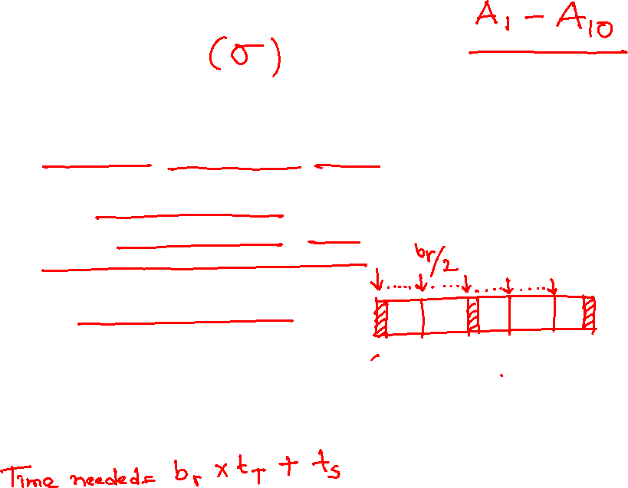
Selection Operation
File scan
Algorithm A1 (linear search). Scan each file block and test all records to see whether they satisfy the selection condition.
Cost estimate = b_{r} block transfers + 1 seek
b_{r} denotes number of blocks containing records from relation r
If selection is on a key attribute, can stop on finding record
cost = (b_{r} /2) block transfers + 1 seek
Linear search can be applied regardless of
selection condition or
ordering of records in the file, or
availability of indices
Note: binary search generally does not make sense since data is not stored consecutively
except when there is an index available,
and binary search requires more seeks than index search

Slide 14
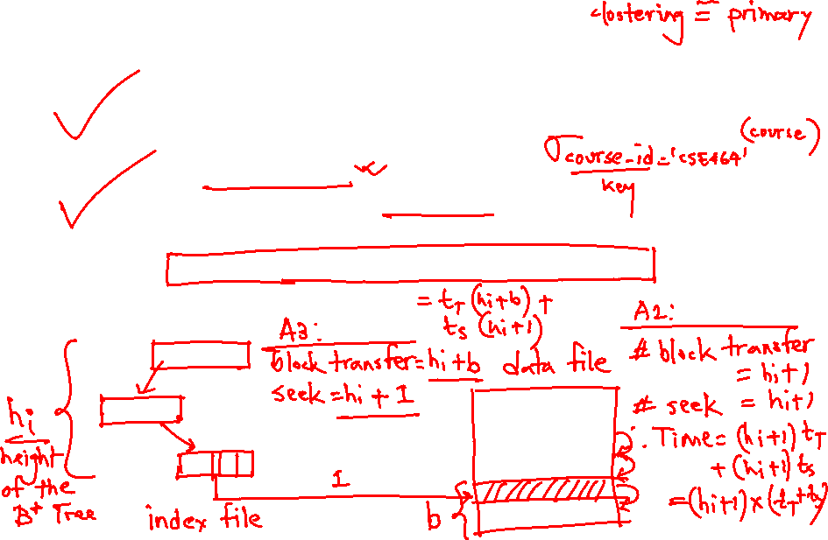
Selections Using Indices
Index scan – search algorithms that use an index
selection condition must be on search-key of index.
A2 (clustering index, equality on key). Retrieve a single record that satisfies the corresponding equality condition
Cost = (h_{i} + 1) * (t_{T} + t_{S})
A3 (clustering index, equality on nonkey) Retrieve multiple records.
Records will be on consecutive blocks
Let b = number of blocks containing matching records
Cost = h_{i} * (t_{T} + t_{S}) + t_{S} + t_{T} * b

Slide 15








Slide 16










Slide 17
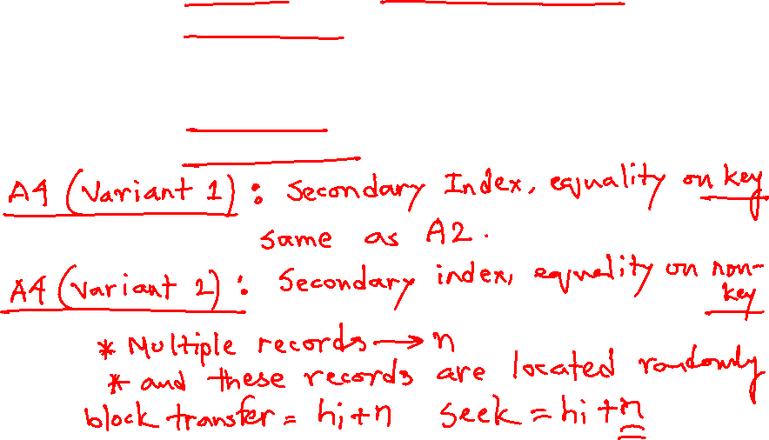
Selections Using Indices
A4 (secondary index, equality on key/non-key).
Retrieve a single record if the search-key is a candidate key
Cost = (h_{i} + 1) * (t_{T} + t_{S})
Retrieve multiple records if search-key is not a candidate key
each of n matching records may be on a different block
Cost = (h_{i} + n) * (t_{T} + t_{S})
Can be very expensive!
Notes:
17

Slide 18








Slide 19









Selections Involving Comparisons
Can implement selections of the form σ_{A≤V} (r) or σ_{A ≥ V}(r) by using
a linear file scan,
or by using indices in the following ways:
A5 (clustering index, comparison). (Relation is sorted on A)
For σ_{A ≥ V}(r) use index to find first tuple ≥ v and scan relation sequentially from there
For σ_{A≤V} (r) just scan relation sequentially till first tuple > v; do not use index
A6 (secondary index, comparison).
For σ_{A ≥ V}(r) use index to find first index entry ≥ v and scan index sequentially from there, to find pointers to records.
For σ_{A≤V} (r) just scan leaf pages of index finding pointers to records, till first entry > v
In either case, retrieve records that are pointed to
requires an I/O per record; Linear file scan may be cheaper!

Slide 20





Slide 21







Slide 22










Slide 23
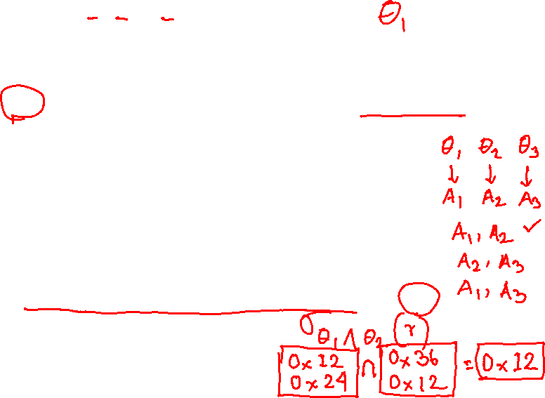
Implementation of Complex Selections
Conjunction: σ_{θ1}∧ _{θ2}∧. . . _{θn}(r)
A7 (conjunctive selection using one index).
Select a combination of θ_{i} and algorithms A1 through A7 that results in the least cost for σ_{θi} (r).
Test other conditions on tuple after fetching it into memory buffer.
A8 (conjunctive selection using composite index).
Use appropriate composite (multiple-key) index if available.
A9 (conjunctive selection by intersection of identifiers).
Requires indices with record pointers.
Use corresponding index for each condition, and take intersection of all the obtained sets of record pointers.
Then fetch records from file
If some conditions do not have appropriate indices, apply test in memory.

Slide 24
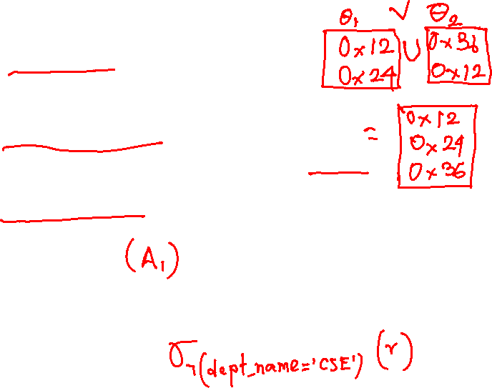
Algorithms for Complex Selections
Disjunction:σ_{θ1}∨ _{θ2} ∨. . . _{θn} (r).
A10 (disjunctive selection by union of identifiers).
Applicable if all conditions have available indices.
Otherwise use linear scan.
Use corresponding index for each condition, and take union of all the obtained sets of record pointers.
Then fetch records from file
Negation: σ_{¬θ}(r)
Use linear scan on file
If very few records satisfy ¬θ, and an index is applicable to θ
Find satisfying records using index and fetch from file

Slide 25
Bitmap Index Scan
The bitmap index scan algorithm of PostgreSQL
Bridges gap between secondary index scan and linear file scan when number of matching records is not known before execution
Bitmap with 1 bit per page in relation
Steps:
Index scan used to find record ids, and set bit of corresponding page in bitmap
Linear file scan fetching only pages with bit set to 1
Performance
Similar to index scan when only a few bits are set
Similar to linear file scan when most bits are set
Never behaves very badly compared to best alternative

Slide 26
Sorting
We may build an index on the relation, and then use the index to read the relation in sorted order. May lead to one disk block access for each tuple.
For relations that fit in memory, techniques like quicksort can be used.
For relations that don’t fit in memory, external sort-merge is a good choice.

Slide 27
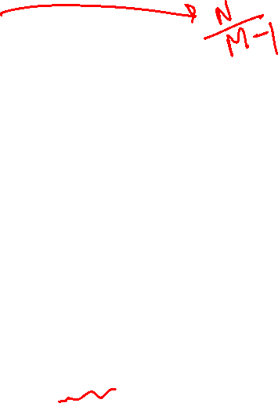
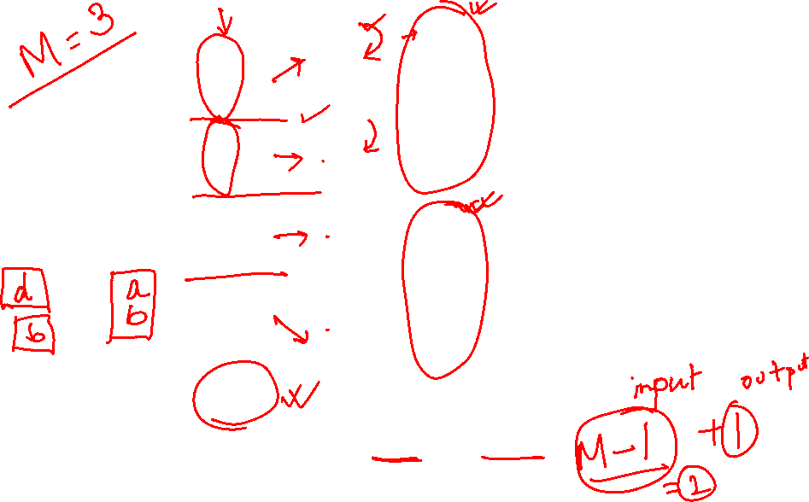
Example: External Sorting Using Sort-Merge

Slide 28
External Sort-Merge
Let M denote memory size (in pages).
1. Create sorted runs. Let i be 0 initially. Repeatedly do the following till the end of the relation: (a) Read M blocks of relation into memory (b) Sort the in-memory blocks (c) Write sorted data to run R_{i}; increment i.
Let the final value of i be N
2. Merge the runs (next slide)…..

Slide 29
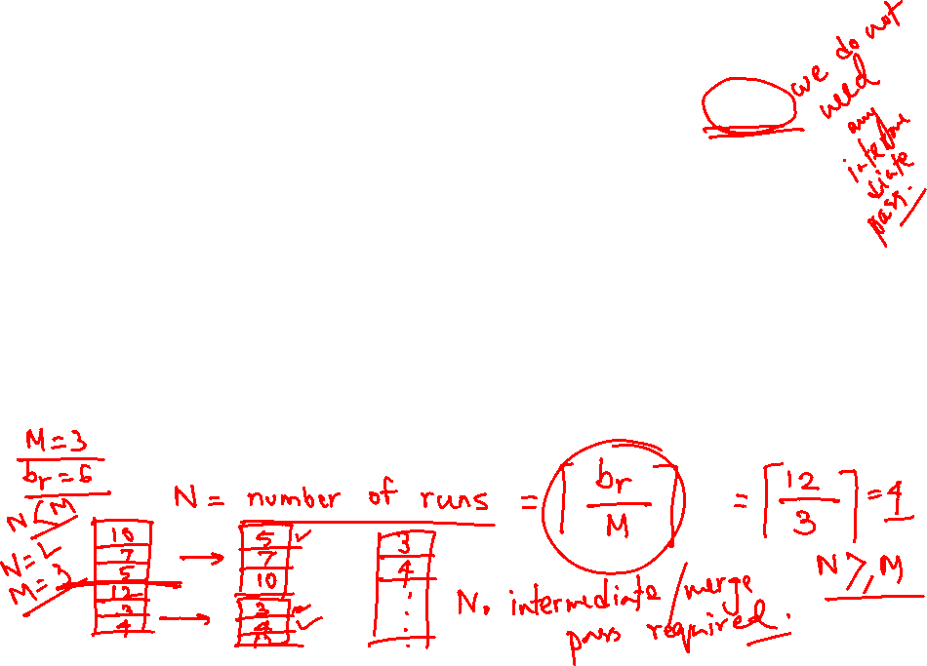
External Sort-Merge (Cont.)
2. Merge the runs (N-way merge). We assume (for now) that N < M.
1. Use N blocks of memory to buffer input runs, and 1 block to buffer output. Read the first block of each run into its buffer page
2. repeat
Select the first record (in sort order) among all buffer pages
Write the record to the output buffer. If the output buffer is full write it to disk.
Delete the record from its input buffer page. If the buffer page becomes empty then read the next block (if any) of the run into the buffer.
3. until all input buffer pages are empty:

Slide 30

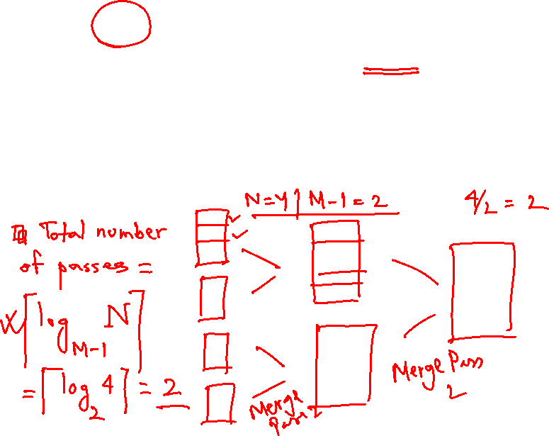
External Sort-Merge (Cont.)
If N ≥ M, several merge passes are required.
In each pass, contiguous groups of M - 1 runs are merged.
A pass reduces the number of runs by a factor of M -1, and creates runs longer by the same factor.
E.g. If M=11, and there are 90 runs, one pass reduces the number of runs to 9, each 10 times the size of the initial runs
Repeated passes are performed till all runs have been merged into one.

Slide 31
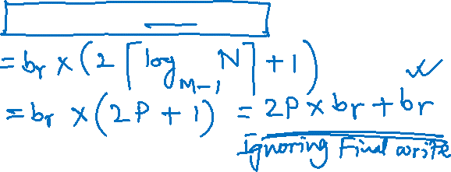
External Merge Sort (Cont.)
Cost analysis:
1 block per run leads to too many seeks during merge
Instead use b_{b} buffer blocks per run
➔ read/write b_{b} blocks at a time
Can merge ⎣M/b_{b}⎦–1 runs in one pass
Total number of merge passes required: ⎡log _{⎣M/bb⎦–1}(b_{r}/M)⎤.
Block transfers for initial run creation as well as in each pass is 2b_{r}
for final pass, we don’t count write cost
we ignore final write cost for all operations since the output of an operation may be sent to the parent operation without being written to disk
Thus total number of block transfers for external sorting: b_{r} ( 2 ⎡log _{⎣M/bb⎦–1} (b_{r} / M)⎤ + 1) ⎡
Seeks: next slide

Slide 32

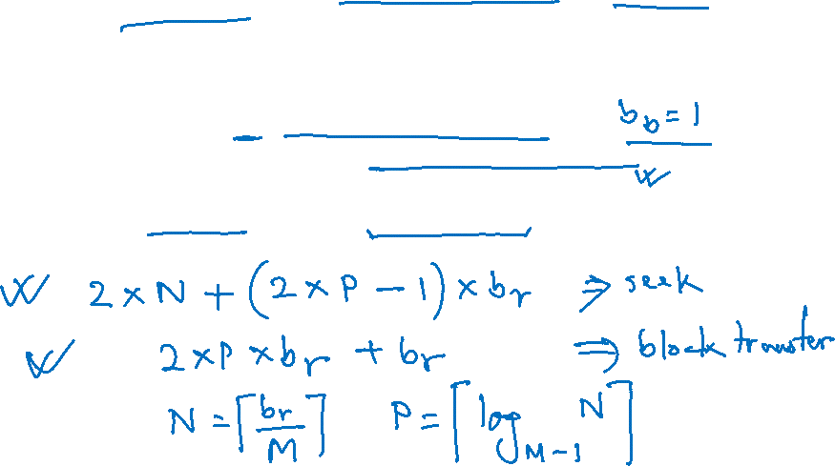
External Merge Sort (Cont.)
Cost of seeks
During run generation: one seek to read each run and one seek to write each run
2 ⎡b_{r} / M⎤
During the merge phase
Need 2 ⎡b_{r} / b_{b}⎤ seeks for each merge pass
except the final one which does not require a write
Total number of seeks: 2 ⎡b_{r} / M⎤ + ⎡b_{r} / b_{b}⎤ (2 ⎡log_{⎣M/bb⎦–1}(b_{r} / M)⎤ -1)

Slide 33
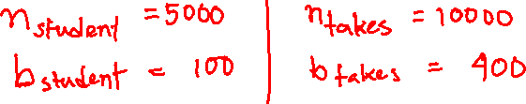
Join Operation
Several different algorithms to implement joins
Nested-loop join
Block nested-loop join
Indexed nested-loop join
Merge-join
Hash-join
Choice based on cost estimate
Examples use the following information
Number of records of student: 5,000 takes: 10,000
Number of blocks of student: 100 takes: 400

Slide 34
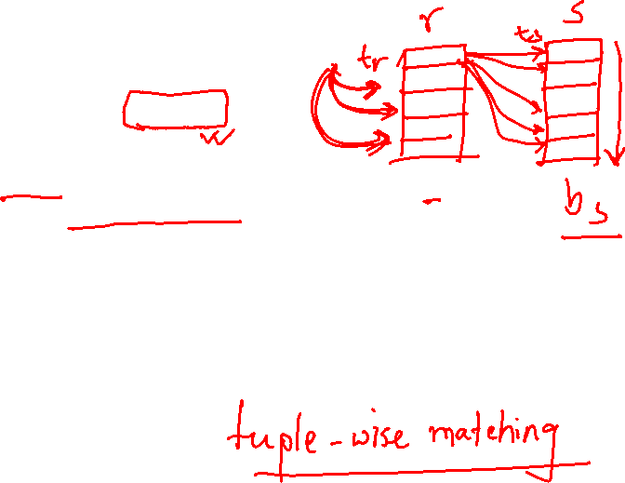
Nested-Loop Join
To compute the theta join r ⨝ _{θ} s for each tuple t_{r} in r do begin for each tuple t_{s} in s do begin test pair (t_{r},t_{s}) to see if they satisfy the join condition θ if they do, add t_{r} • t_{s} to the result. end end
r is called the outer relation and s the inner relation of the join.
Requires no indices and can be used with any kind of join condition.
Expensive since it examines every pair of tuples in the two relations.

Slide 35
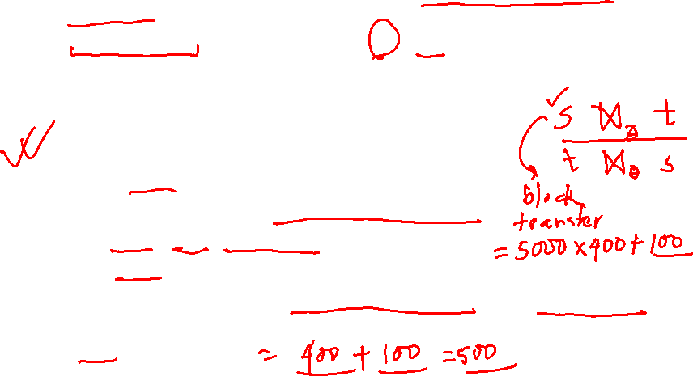
Nested-Loop Join (Cont.)
In the worst case, if there is enough memory only to hold one block of each relation, the estimated cost is n_{r} ∗ b_{s} + b_{r} block transfers, plus n_{r} + b_{r} seeks
If the smaller relation fits entirely in memory, use that as the inner relation.
Reduces cost to b_{r} + b_{s} block transfers and 2 seeks
Assuming worst case memory availability cost estimate is
with student as outer relation:
5000 ∗ 400 + 100 = 2,000,100 block transfers,
5000 + 100 = 5100 seeks
with takes as the outer relation
10000 ∗ 100 + 400 = 1,000,400 block transfers and 10,400 seeks
If smaller relation (student) fits entirely in memory, the cost estimate will be 500 block transfers.
Block nested-loops algorithm (next slide) is preferable.

Slide 36
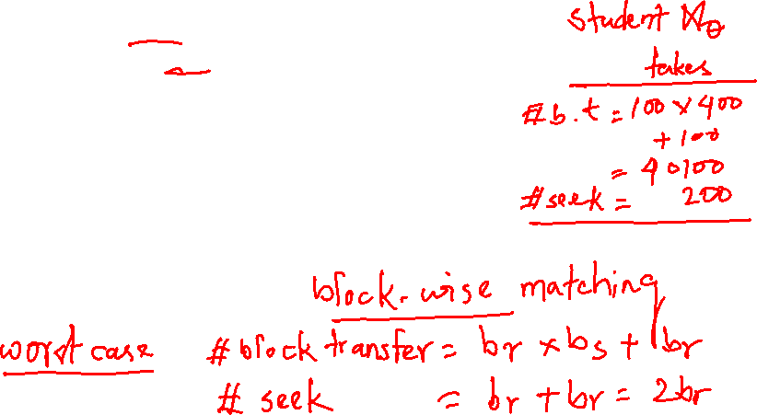
Block Nested-Loop Join
Variant of nested-loop join in which every block of inner relation is paired with every block of outer relation.
for each block B_{r} of r do begin for each block B_{s} of s do begin for each tuple t_{r} in B_{r} do begin for each tuple t_{s} in B_{s} do begin Check if (t_{r},t_{s}) satisfy the join condition if they do, add t_{r} • t_{s} to the result. end end end end

Slide 37
Block Nested-Loop Join (Cont.)
Worst case estimate: b_{r} ∗ b_{s} + b_{r} block transfers + 2 * b_{r} seeks
Each block in the inner relation s is read once for each block in the outer relation
Best case: b_{r} + b_{s} block transfers + 2 seeks.
Improvements to nested loop and block nested loop algorithms:
In block nested-loop, use M — 2 disk blocks as blocking unit for outer relations, where M = memory size in blocks; use remaining two blocks to buffer inner relation and output
Cost = ⎡b_{r} / (M-2)⎤ ∗ b_{s} + b_{r} block transfers + 2 ⎡b_{r} / (M-2)⎤ seeks
If equi-join attribute forms a key or inner relation, stop inner loop on first match
Scan inner loop forward and backward alternately, to make use of the blocks remaining in buffer (with LRU replacement)
Use index on inner relation if available (next slide)

Slide 38
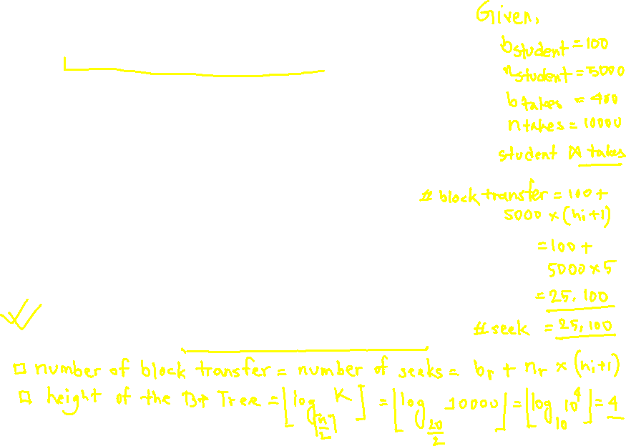
Indexed Nested-Loop Join
Index lookups can replace file scans if
join is an equi-join or natural join and
an index is available on the inner relation’s join attribute
Can construct an index just to compute a join.
For each tuple t_{r} in the outer relation r, use the index to look up tuples in s that satisfy the join condition with tuple t_{r}.
Worst case: buffer has space for only one page of r, and, for each tuple in r, we perform an index lookup on s.
Cost of the join: b_{r} (t_{T} + t_{S}) + n_{r} ∗ c
Where c is the cost of traversing index and fetching all matching s tuples for one tuple or r
c can be estimated as cost of a single selection on s using the join condition.
If indices are available on join attributes of both r and s, use the relation with fewer tuples as the outer relation.

Slide 39
Example of Nested-Loop Join Costs
Compute student ⨝ takes, with student as the outer relation.
Let takes have a primary B⁺-tree index on the attribute ID, which contains 20 entries in each index node.
Since takes has 10,000 tuples, the height of the tree is 4, and one more access is needed to find the actual data
student has 5000 tuples
Cost of block nested loops join
400*100 + 100 = 40,100 block transfers + 2 * 100 = 200 seeks
assuming worst case memory
may be significantly less with more memory
Cost of indexed nested loops join
100 + 5000 * 5 = 25,100 block transfers and seeks.
CPU cost likely to be less than that for block nested loops join

Slide 40
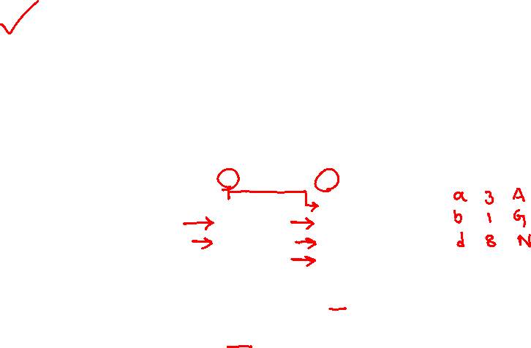
Merge-Join
1. Sort both relations on their join attribute (if not already sorted on the join
attributes).
2. Merge the sorted relations to join them
1. Join step is similar to the merge stage of the sort-merge algorithm.
2. Main difference is handling of duplicate values in join attribute —
every pair with same value on join attribute must be matched
3. Detailed algorithm in book

Slide 41
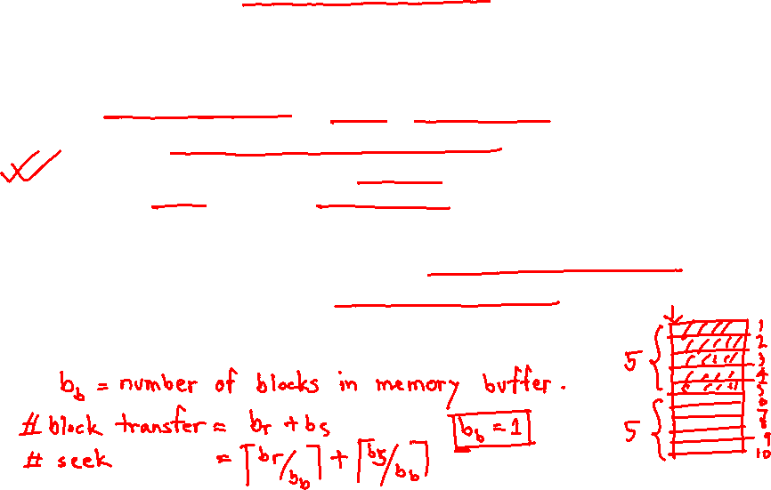
Merge-Join (Cont.)
Can be used only for equi-joins and natural joins
Each block needs to be read only once (assuming all tuples for any given value of the join attributes fit in memory
Thus the cost of merge join is: b_{r} + b_{s} block transfers + ⎡b_{r} / b_{b}⎤ + ⎡b_{s} / b_{b}⎤ seeks
+ the cost of sorting if relations are unsorted.
hybrid merge-join: If one relation is sorted, and the other has a secondary B⁺-tree index on the join attribute
Merge the sorted relation with the leaf entries of the B⁺-tree .
Sort the result on the addresses of the unsorted relation’s tuples
Scan the unsorted relation in physical address order and merge with previous result, to replace addresses by the actual tuples
Sequential scan more efficient than random lookup

Slide 42
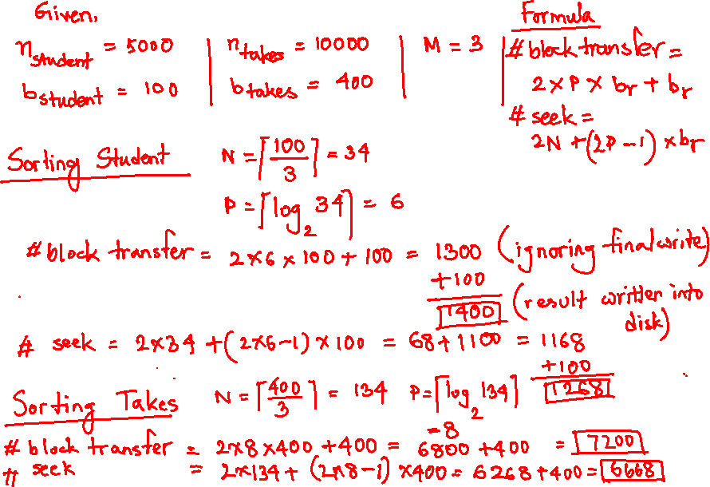
Cost of Merge Join

Slide 43
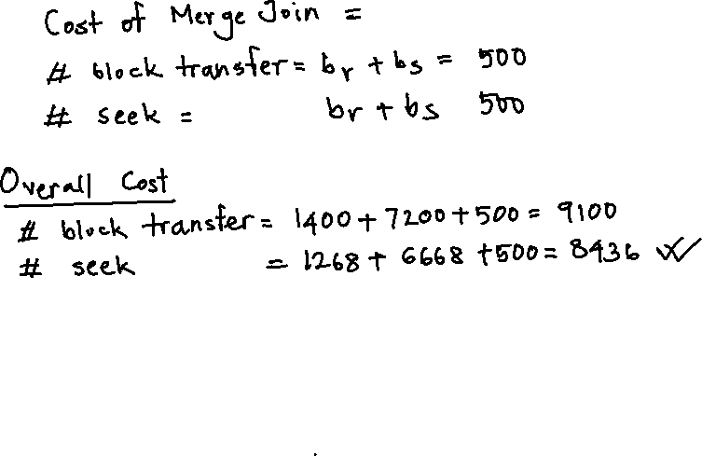

Slide 44
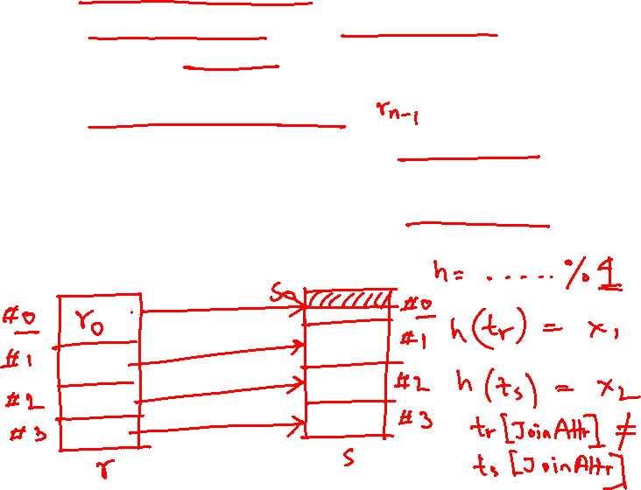
Hash-Join
Applicable for equi-joins and natural joins.
A hash function h is used to partition tuples of both relations
h maps JoinAttrs values to {0, 1, ..., n}, where JoinAttrs denotes the common attributes of r and s used in the natural join.
r₀, r₁, . . ., r_{n} denote partitions of r tuples
Each tuple t_{r} ∈ r is put in partition r_{i} where i = h(t_{r} [JoinAttrs]).
r₀,, r₁. . ., r_{n} denotes partitions of s tuples
Each tuple t_{s} ∈s is put in partition s_{i}, where i = h(t_{s} [JoinAttrs]).
Note: In book, Figure 12.10 r_{i} is denoted as H_{ri,} s_{i} is denoted as H_{si} and n is denoted as n_{h.}

Slide 45
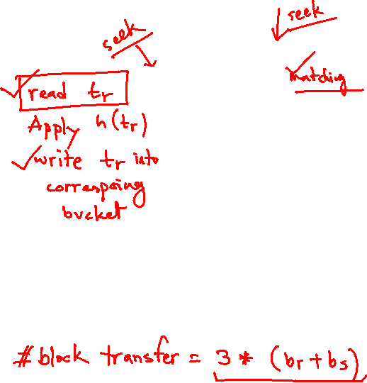
Hash-Join (Cont.)

Slide 46
Hash-Join (Cont.)
r tuples in r_{i} need only to be compared with s tuples in s_{i} Need not be compared with s tuples in any other partition, since:
an r tuple and an s tuple that satisfy the join condition will have the same value for the join attributes.
If that value is hashed to some value i, the r tuple has to be in r_{i} and the s tuple in s_{i}.

Slide 47
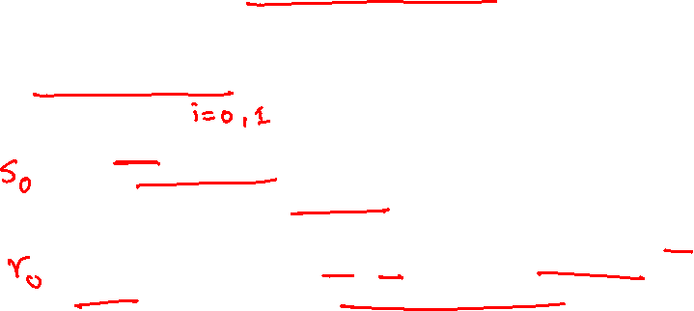
Hash-Join Algorithm
The hash-join of r and s is computed as follows.
1. Partition the relation s using hashing function h. When partitioning a relation, one block of memory is reserved as the output buffer for each partition.
2. Partition r similarly.
3. For each i:
(a) Load s_{i} into memory and build an in-memory hash index on it using the join attribute. This hash index uses a different hash function than the earlier one h.
(b) Read the tuples in r_{i} from the disk one by one. For each tuple t_{r} locate each matching tuple t_{s} in s_{i} using the in-memory hash index. Output the concatenation of their attributes.
Relation s is called the build input and r is called the probe input.

Slide 48
Hash-Join algorithm (Cont.)
The value n and the hash function h is chosen such that each s_{i} should fit in memory.
Typically n is chosen as ⎡b_{s}/M⎤ * f where f is a “fudge factor”, typically around 1.2
The probe relation partitions s_{i} need not fit in memory
Recursive partitioning required if number of partitions n is greater than number of pages M of memory.
instead of partitioning n ways, use M – 1 partitions for s
Further partition the M – 1 partitions using a different hash function
Use same partitioning method on r
Rarely required: e.g., with block size of 4 KB, recursive partitioning not needed for relations of < 1GB with memory size of 2MB, or relations of < 36 GB with memory of 12 MB

Slide 49
Handling of Overflows
Partitioning is said to be skewed if some partitions have significantly more tuples than some others
Hash-table overflow occurs in partition s_{i} if s_{i} does not fit in memory. Reasons could be
Many tuples in s with same value for join attributes
Bad hash function
Overflow resolution can be done in build phase
Partition s_{i} is further partitioned using different hash function.
Partition r_{i} must be similarly partitioned.
Overflow avoidance performs partitioning carefully to avoid overflows during build phase
E.g., partition build relation into many partitions, then combine them
Both approaches fail with large numbers of duplicates
Fallback option: use block nested loops join on overflowed partitions

Slide 50
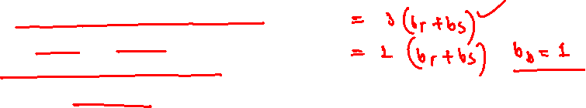
Cost of Hash-Join
If recursive partitioning is not required: cost of hash join is 3(b_{r} + b_{s}) +4 ∗ n_{h} block transfers + 2( ⎡b_{r} / b_{b}⎤ + ⎡b_{s} / b_{b}⎤) seeks
If recursive partitioning required:
number of passes required for partitioning build relation s to less than M blocks per partition is ⎡log_{⎣M/bb⎦–1}(b_{s}/M)⎤
best to choose the smaller relation as the build relation.
Total cost estimate is: 2(b_{r} + b_{s}) ⎡log_{⎣M/bb⎦–1}(b_{s}/M)⎤ + b_{r} + b_{s} block transfers + 2(⎡b_{r} / b_{b}⎤ + ⎡b_{s} / b_{b}⎤) ⎡log_{⎣M/bb⎦–1}(b_{s}/M) ⎤ seeks
If the entire build input can be kept in main memory no partitioning is required
Cost estimate goes down to b_{r} + b_{s}.

Slide 51
Example of Cost of Hash-Join
instructor ⨝ teaches
Assume that memory size is 20 blocks
b_{instructor}= 100 and b_{teaches} = 400.
instructor is to be used as build input. Partition it into five partitions, each of size 20 blocks. This partitioning can be done in one pass.
Similarly, partition teaches into five partitions,each of size 80. This is also done in one pass.
Therefore total cost, ignoring cost of writing partially filled blocks:
3(100 + 400) = 1500 block transfers + 2( ⎡100/3⎤ + ⎡400/3⎤) = 336 seeks

Slide 52
Hybrid Hash–Join
Useful when memory sized are relatively large, and the build input is bigger than memory.
Main feature of hybrid hash join:
Keep the first partition of the build relation in memory.
E.g. With memory size of 25 blocks, instructor can be partitioned into five partitions, each of size 20 blocks.
Division of memory:
The first partition occupies 20 blocks of memory
1 block is used for input, and 1 block each for buffering the other 4 partitions.
teaches is similarly partitioned into five partitions each of size 80
the first is used right away for probing, instead of being written out
Cost of 3(80 + 320) + 20 +80 = 1300 block transfers for hybrid hash join, instead of 1500 with plain hash-join.
Hybrid hash-join most useful if M >>

Slide 53
Complex Joins
Join with a conjunctive condition:
r ⨝ _{θ1∧ θ 2∧... ∧ θ n} s
Either use nested loops/block nested loops, or
Compute the result of one of the simpler joins r ⨝ _{θi} s
final result comprises those tuples in the intermediate result that satisfy the remaining conditions
θ₁ ∧ . . . ∧ θ_{i –1} ∧ θ_{i +1} ∧ . . . ∧ θ_{n}
Join with a disjunctive condition
r ⨝ _{θ1 ∨ θ2 ∨... ∨ θn} s
Either use nested loops/block nested loops, or
Compute as the union of the records in individual joins r ⨝ _{θi} s:
(r ⨝ _{θ1} s) ∪ (r ⨝ _{θ2} s) ∪ . . . ∪ (r ⨝ _{θn} s)

Slide 54
Joins over Spatial Data
No simple sort order for spatial joins
Indexed nested loops join with spatial indices
R-trees, quad-trees, k-d-B-trees

Slide 55
Other Operations
Duplicate elimination can be implemented via hashing or sorting.
On sorting duplicates will come adjacent to each other, and all but one set of duplicates can be deleted.
Optimization: duplicates can be deleted during run generation as well as at intermediate merge steps in external sort-merge.
Hashing is similar – duplicates will come into the same bucket.
Projection:
perform projection on each tuple
followed by duplicate elimination.

Slide 56
Other Operations : Aggregation
Aggregation can be implemented in a manner similar to duplicate elimination.
Sorting or hashing can be used to bring tuples in the same group together, and then the aggregate functions can be applied on each group.
Optimization: partial aggregation
combine tuples in the same group during run generation and intermediate merges, by computing partial aggregate values
For count, min, max, sum: keep aggregate values on tuples found so far in the group.
When combining partial aggregate for count, add up the partial aggregates
For avg, keep sum and count, and divide sum by count at the end

Slide 57
Other Operations : Set Operations
Set operations (∪, ∩ and ⎯): can either use variant of merge-join after sorting, or variant of hash-join.
E.g., Set operations using hashing:
1. Partition both relations using the same hash function
2. Process each partition i as follows.
Using a different hashing function, build an in-memory hash index on r_{i}.
Process s_{i} as follows
r ∪ s:
Add tuples in s_{i} to the hash index if they are not already in it.
At end of s_{i} add the tuples in the hash index to the result.

Slide 58
Other Operations : Set Operations
E.g., Set operations using hashing:
1. as before partition r and s,
2. as before, process each partition i as follows
build a hash index on r_{i}
Process s_{i} as follows
r ∩ s:
output tuples in s_{i} to the result if they are already there in the hash index
r – s:
for each tuple in s_{i}, if it is there in the hash index, delete it from the index.
At end of s_{i} add remaining tuples in the hash index to the result.
Notes:
58

Slide 59
Answering Keyword Queries
Indices mapping keywords to documents
For each keyword, store sorted list of document IDs that contain the keyword
Commonly referred to as a inverted index
E.g.,: database: d1, d4, d11, d45, d77, d123 distributed: d4, d8, d11, d56, d77, d121, d333
To answer a query with several keywords, compute intersection of lists corresponding to those keywords
To support ranking, inverted lists store extra information
“Term frequency” of the keyword in the document
“Inverse document frequency” of the keyword
Page rank of the document/web page

Slide 60
Other Operations : Outer Join
Outer join can be computed either as
A join followed by addition of null-padded non-participating tuples.
by modifying the join algorithms.
Modifying merge join to compute r ⟕ s
In r ⟕ s, non participating tuples are those in r – Π_{R}(r ⨝ s)
Modify merge-join to compute r ⟕ s:
During merging, for every tuple t_{r} from r that do not match any tuple in s, output t_{r} padded with nulls.
Right outer-join and full outer-join can be computed similarly.

Slide 61
Other Operations : Outer Join
Modifying hash join to compute r ⟕ s
If r is probe relation, output non-matching r tuples padded with nulls
If r is build relation, when probing keep track of which r tuples matched s tuples. At end of s_{i} output non-matched r tuples padded with nulls
Notes:
61

Slide 62
Evaluation of Expressions
So far: we have seen algorithms for individual operations
Alternatives for evaluating an entire expression tree
Materialization: generate results of an expression whose inputs are relations or are already computed, materialize (store) it on disk. Repeat.
Pipelining: pass on tuples to parent operations even as an operation is being executed
We study above alternatives in more detail

Slide 63
Materialization
Materialized evaluation: evaluate one operation at a time, starting at the lowest-level. Use intermediate results materialized into temporary relations to evaluate next-level operations.
E.g., in figure below, compute and store then compute the store its join with instructor, and finally compute the projection on name.

Slide 64
Materialization (Cont.)
Materialized evaluation is always applicable
Cost of writing results to disk and reading them back can be quite high
Our cost formulas for operations ignore cost of writing results to disk, so
Overall cost = Sum of costs of individual operations + cost of writing intermediate results to disk
Double buffering: use two output buffers for each operation, when one is full write it to disk while the other is getting filled
Allows overlap of disk writes with computation and reduces execution time

Slide 65
Pipelining
Pipelined evaluation: evaluate several operations simultaneously, passing the results of one operation on to the next.
E.g., in previous expression tree, don’t store result of
instead, pass tuples directly to the join.. Similarly, don’t store result of join, pass tuples directly to projection.
Much cheaper than materialization: no need to store a temporary relation to disk.
Pipelining may not always be possible – e.g., sort, hash-join.
For pipelining to be effective, use evaluation algorithms that generate output tuples even as tuples are received for inputs to the operation.
Pipelines can be executed in two ways: demand driven and producer driven

Slide 66
Pipelining (Cont.)
In demand driven or lazy evaluation
system repeatedly requests next tuple from top level operation
Each operation requests next tuple from children operations as required, in order to output its next tuple
In between calls, operation has to maintain “state” so it knows what to return next
In producer-driven or eager pipelining
Operators produce tuples eagerly and pass them up to their parents
Buffer maintained between operators, child puts tuples in buffer, parent removes tuples from buffer
if buffer is full, child waits till there is space in the buffer, and then generates more tuples
System schedules operations that have space in output buffer and can process more input tuples
Alternative name: pull and push models of pipelining

Slide 67
Pipelining (Cont.)
Implementation of demand-driven pipelining
Each operation is implemented as an iterator implementing the following operations
open()
E.g., file scan: initialize file scan
state: pointer to beginning of file
E.g., merge join: sort relations;
state: pointers to beginning of sorted relations
next()
E.g., for file scan: Output next tuple, and advance and store file pointer
E.g., for merge join: continue with merge from earlier state till next output tuple is found. Save pointers as iterator state.
close()

Slide 68
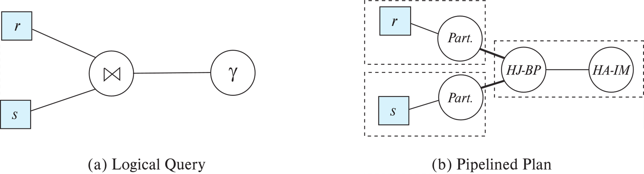
Blocking Operations
Blocking operations: cannot generate any output until all input is consumed
E.g., sorting, aggregation, …
But can often consume inputs from a pipeline, or produce outputs to a pipeline
Key idea: blocking operations often have two suboperations
E.g., for sort: run generation and merge
For hash join: partitioning and build-probe
Treat them as separate operations

Slide 69
Pipeline Stages
Pipeline stages:
All operations in a stage run concurrently
A stage can start only after preceding stages have completed execution

Slide 70
Evaluation Algorithms for Pipelining
Some algorithms are not able to output results even as they get input tuples
E.g., merge join, or hash join
intermediate results written to disk and then read back
Algorithm variants to generate (at least some) results on the fly, as input tuples are read in
E.g., hybrid hash join generates output tuples even as probe relation tuples in the in-memory partition (partition 0) are read in
Double-pipelined join technique: Hybrid hash join, modified to buffer partition 0 tuples of both relations in-memory, reading them as they become available, and output results of any matches between partition 0 tuples
When a new r₀ tuple is found, match it with existing s₀ tuples, output matches, and save it in r₀
Symmetrically for s₀ tuples

Slide 71
Pipelining for Continuous-Stream Data
Data streams
Data entering database in a continuous manner
E.g., Sensor networks, user clicks, …
Continuous queries
Results get updated as streaming data enters the database
Aggregation on windows is often used
E.g., tumbling windows divide time into units, e.g., hours, minutes
Need to use pipelined processing algorithms
Punctuations used to infer when all data for a window has been received

Slide 72
Query Processing in Memory
Query compilation to machine code
Overheads of interpretation
E.g., repeatedly finding attribute location within tuple, from metadata
Overhead of expression evaluation
Compilation can avoid many such overheads and speed up query processing
Often via generation of Java byte code / LLVM, with just-in-time (JIT) compilation
Column-oriented storage
Allows vector operations (in conjunction with compilation)
Cache conscious algorithms

Slide 73
Cache Conscious Algorithms
Goal: minimize cache misses, make best use of data fetched into the cache as part of a cache line
For sorting:
Use runs that are as large as L3 cache (a few megabytes) to avoid cache misses during sorting of a run
Then merge runs as usual in merge-sort
For hash-join
First create partitions such that build+probe partitions fit in memory
Then subpartition further s.t. build subpartition+index fits in L3 cache
Speeds up probe phase significantly by avoiding cache misses
Lay out attributes of tuples to maximize cache usage
Attributes that are often accessed together should be stored adjacent to each other
Use multiple threads for parallel query processing
Cache misses leads to stall of one thread, but others can proceed

Slide 74
End of Chapter 15

